Slide 1
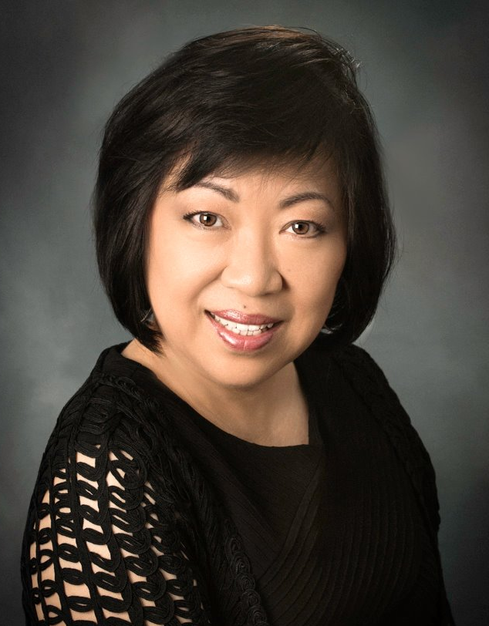
建立強大的信念
Build a Strong Belief
Vikki Lee
執行副總裁級
Executive Field Vice-President
四個佣金週期共賺取HK$345,000
HK$345,000 in 4 Commission weeks
本簡報中提到的收入等級純屬舉例說明，無意代表美安香港超連鎖™店主的一般收入，也無意表示任何超連鎖™店主皆可賺取同等收入。美安香港超連鎖™店主的成功與否，取決於其在發展事業時的努力、才能與投入程度。
The income levels mentioned in the following presentation are for illustration purposes only. They are not intended to represent the income of a typical Market Hong Kong UnFranchise ™Owner, nor are they intended to represent that any given Independent UnFranchise ™ Owner will earn income in that amount. The success of any Market Hong Kong Independent UnFranchise ™ Owner will depend upon the amount of hard work, talent, and dedication which he or she devotes to building his or her Market Hong Kong Business.

Slide 2
FOLLOW ME ON SOCIAL MEDIA
facebook.com/vikkiLee.personal

Slide 3
BELIEF

Slide 4
In 1944, Emmeline Snively, Director of the Blue Book Modeling Agency, told modeling hopeful Norma Jean Baker, “You’d better learn secretarial work or else get married.” She went on to become Marilyn Monroe.

Slide 5
In 1962, four nervous young musicians played their first record audition for the executives of the Decca Recording Company. The executives were not impressed. While turning down this group of musicians, one executive said, “We don’t like their sound. Groups of guitars are on the way out.” The group in question was the Beatles.

Slide 6
Dreams Come True
Dream
+
Vision
+
Belief
+
Action
II
Success

Slide 7
Year 1992…

Slide 8
MPCP
Management Performance Compensation Plan

Slide 9
If you now have 2 types of payroll methods:
(1) WOULD YOU RATHER COLLECT $53,000 IN CASH NOW
(2) WOULD YOU RATHER COLLECT ONE CENT PER DAY COMPOUNDED FOR A 30 DAY MONTH ?

Slide 10
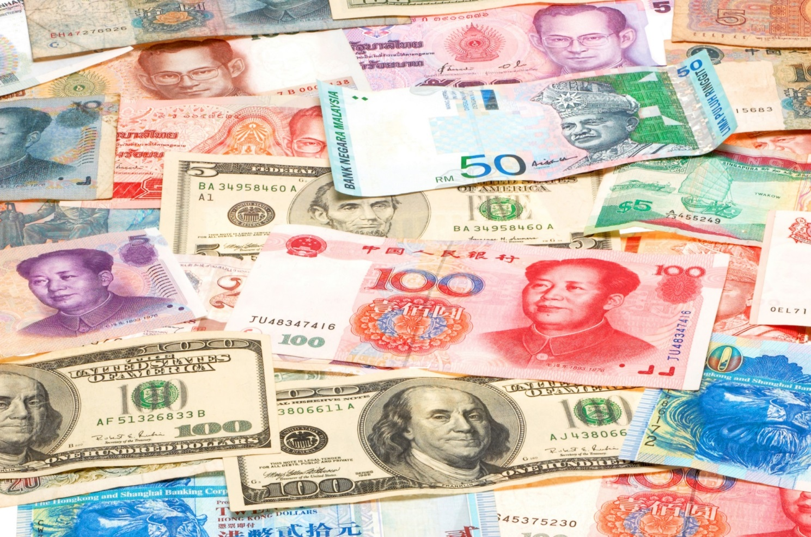
$0.01
$0.02
$0.04
$0.08
$0.16
$0.32
$0.64
$1.28
$2.56
$5.12
$10.24
$20.48
$40.96
$81.92
$163.84
$327.68
$655.36
$1,310.72
$2,621.44
$5,242.88
$10,485.76
$20,971.52
$41,943.04
$83,886.08
$167,772.16
$335,544.32
$671,088.64
$1,342,177.28
$2,684,354.56
$5,368,709.12

Slide 11
When Opportunity comes around...
Is this real?
Is this real?
Can I do it
Can I do it?
Can I do it?
How to do it?
How do to it?

Slide 12
Attitude and Belief
To see is to believe
Notes:
I MUST EMPHASIZE THIS….
THESE ARE KEY SUCCESS FACTORS TO FAST AND STABLE GROWTH
INSTILLING BELIEF
PROVIDING KNOWLEDGE
FOSTERING POSTIVE ATTITUDES
AND SUSTAINING ENTHUSIASM
REMEMBER, INDUSTRY EXPERIENCE AND SUCCESSFUL INDIVIDUALS HAVE PROVEN:
MEETINGS
TRAININGS
RALLIES/SEMINARS
CONVENTIONS
ARE THE BEST WAYS TO IMPLANT THESE FACTORS
AND HOW DO YOU GET PEOPLE TO THESE EVENTS? BY SELLING THEM TICKETS

Slide 13
First Convention
Jan 15, 1993
Less than 80 people

Slide 15
1st Headquarters

Slide 16
12 years later

Slide 17
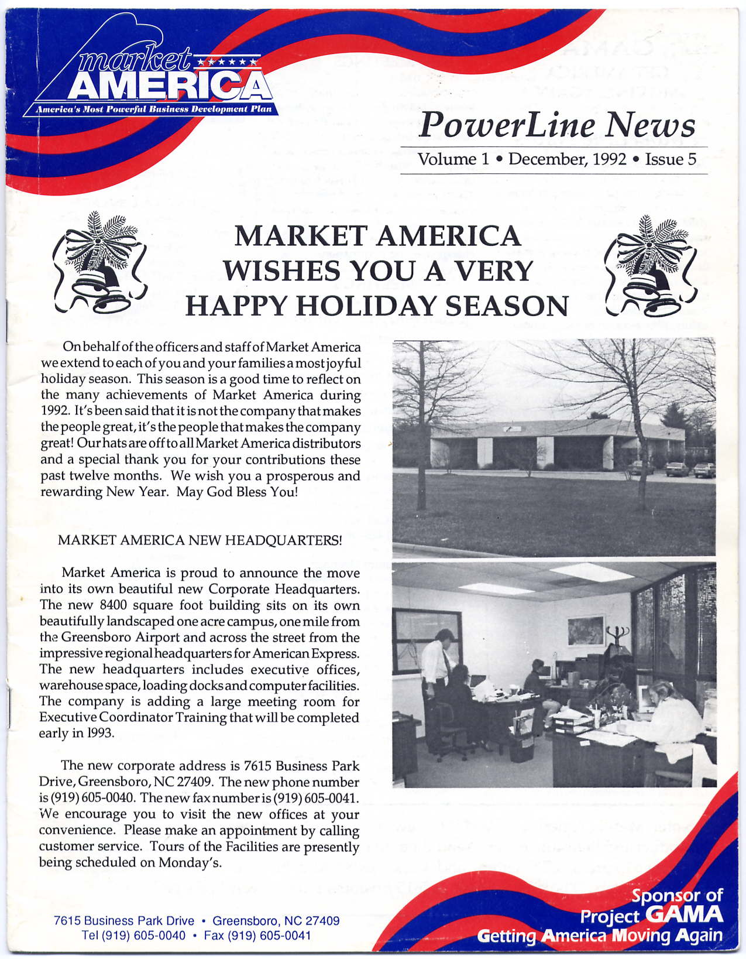
Dec 1992
August 1994

Slide 18
Breakthrough / Magic Moment

Slide 19
1993-1994
Market America
美安公司
MEI-AN
My dreams come true, products are safe and reliable
Everything is splendid, Everyone is confident
Always have something beautiful in sight, Always feel my mind at ease

Slide 20
Year 1993-1994
Finished typing and printing in Chinese
First Assignment (NUOT)
48 Hours Training Get (GSG)
Basic 5
Company, MPCP, Products

Slide 21
Year 1993 – 1994
Q-date - End of month vs. end of week
MPCP - TWO vs. FOUR payments
Auto Ship started
EC and above required to purchase ProPack at US$499

Slide 22
Year 1995 3 No-No’s
1. Don’t build MORE than two legs at the same time.
2. Don’t give away sponsorship.
3. Don’t build two legs for anyone.

Slide 24
Market America (Mei-An)
Training Manual
Chinese Version

Slide 25
Year 1996 - 2002
Chinese group voice mail
Chinese magazine
Moving Up Club → Chinese Leadership Council(CLC)
/CLC & China Night
Chinese Career Manual translation
Chinese interpretation
Chinese Boot Camp (CBC)
Market Australia Opened

Slide 26
Consumers’ Era Huge Business Revolution
Expense become Earning
Necessary living expenses
Gain profit for money you’ve spent)
CTV News: An Amazing Business Model

Slide 27
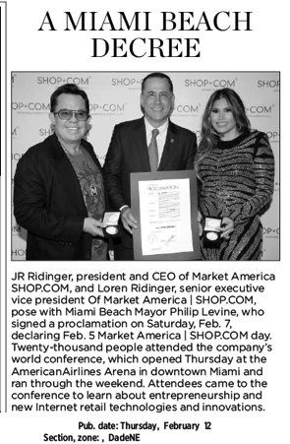
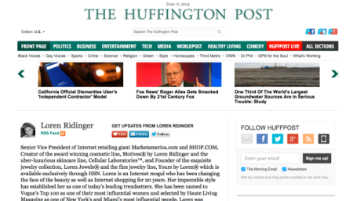
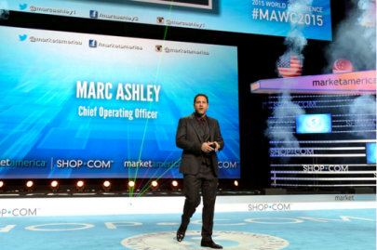
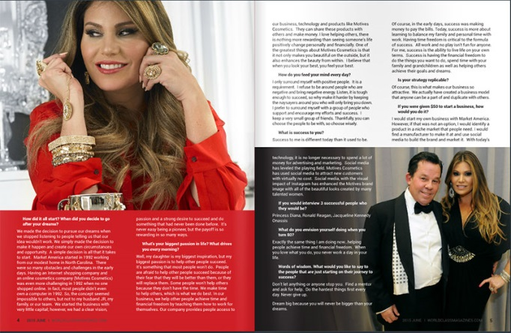
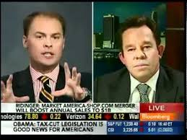
in the news
2013 Torch ]Award Winner Trust • Performance • Integrity BBB of Central NC

Slide 28
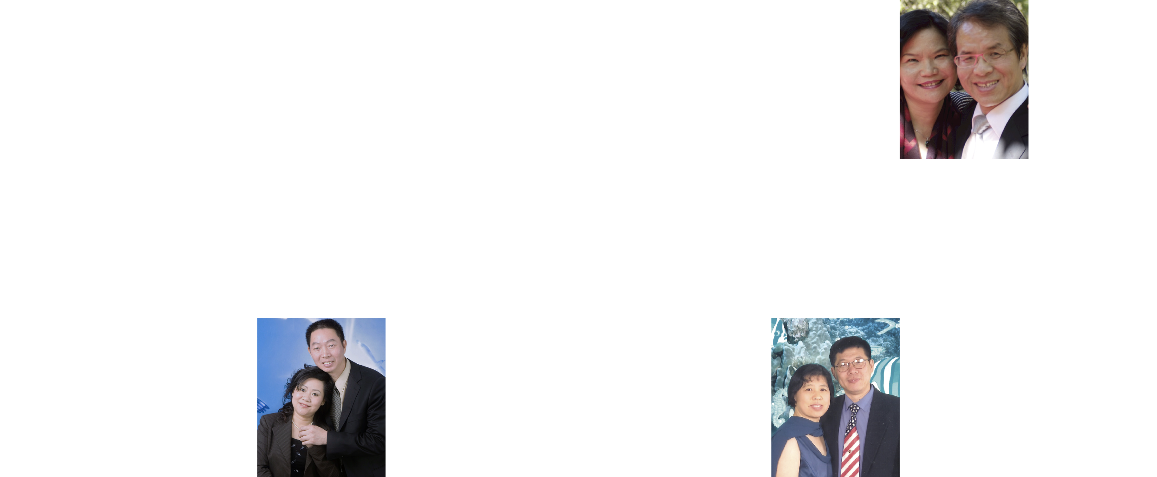
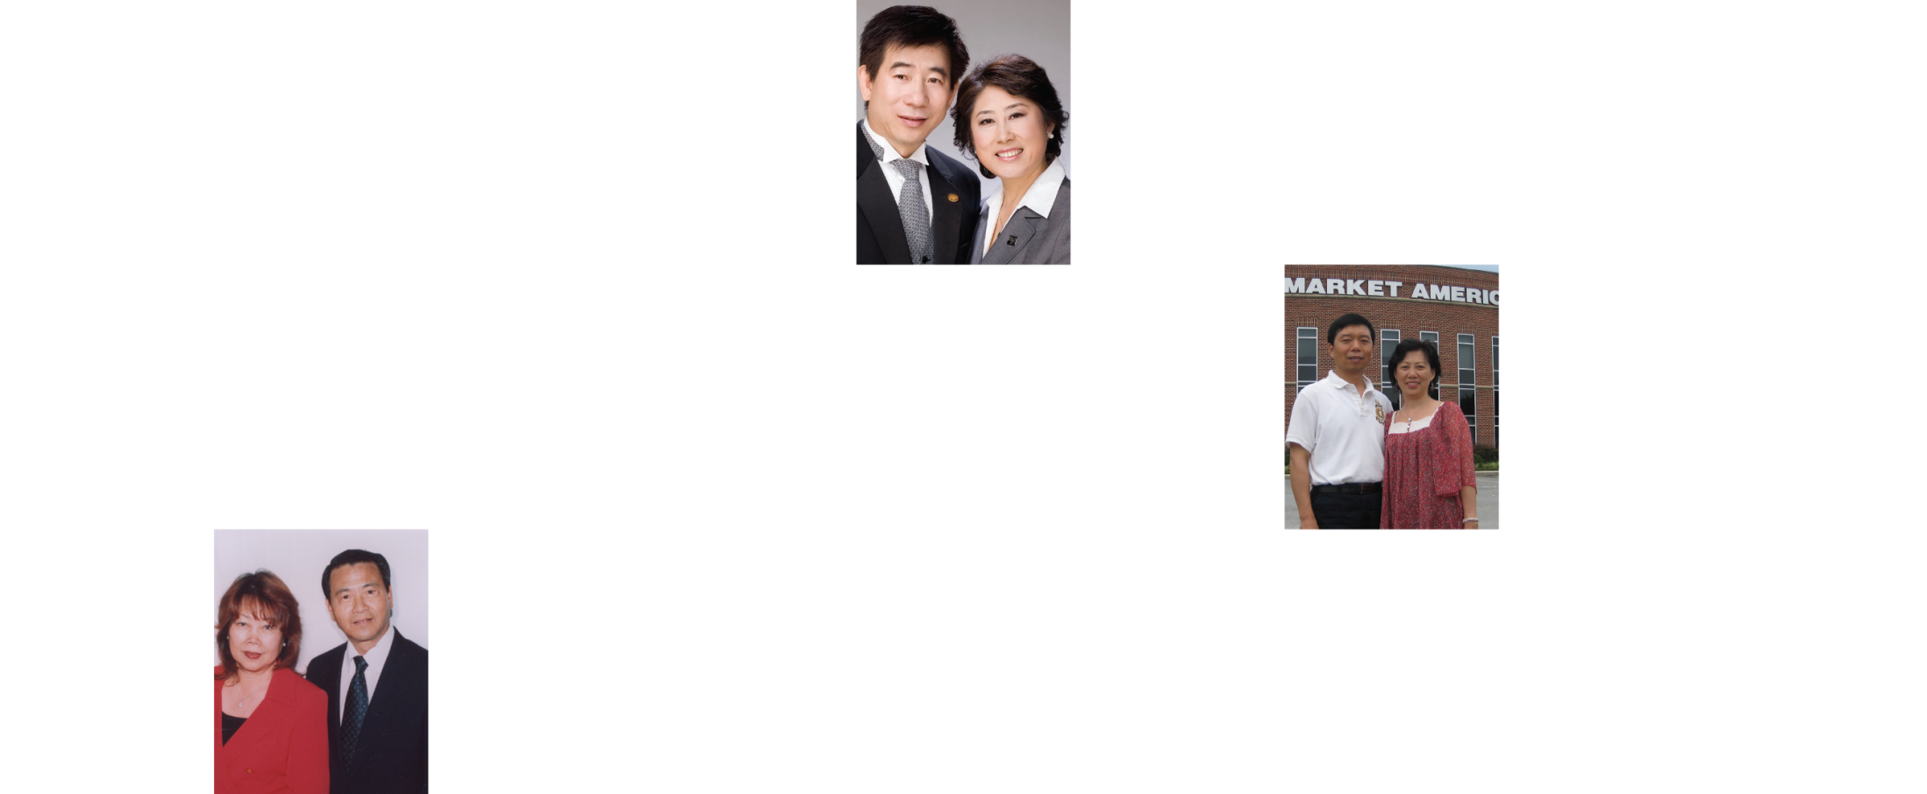
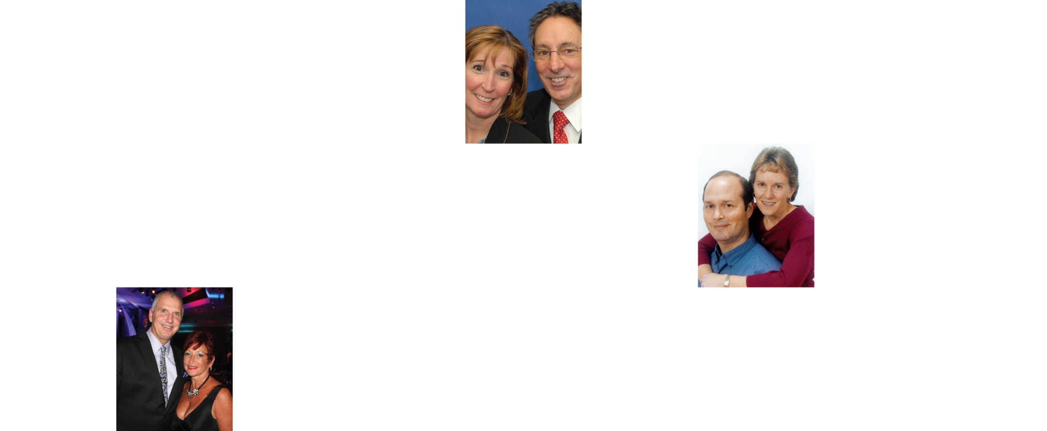
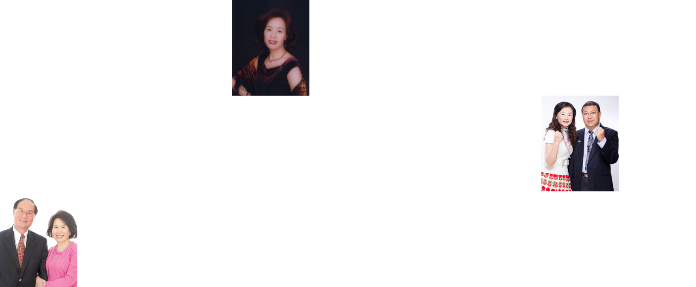
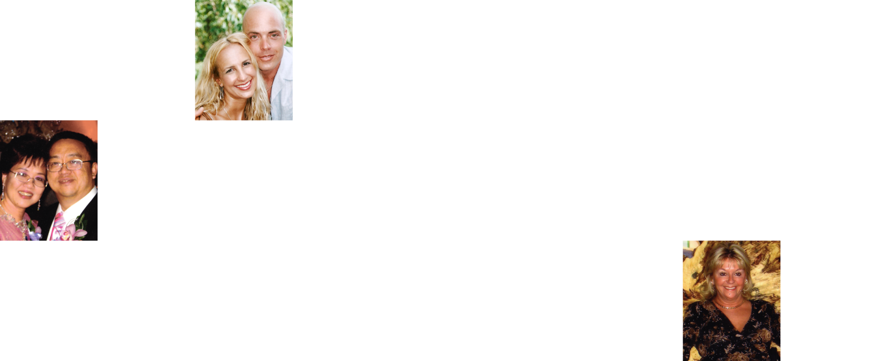
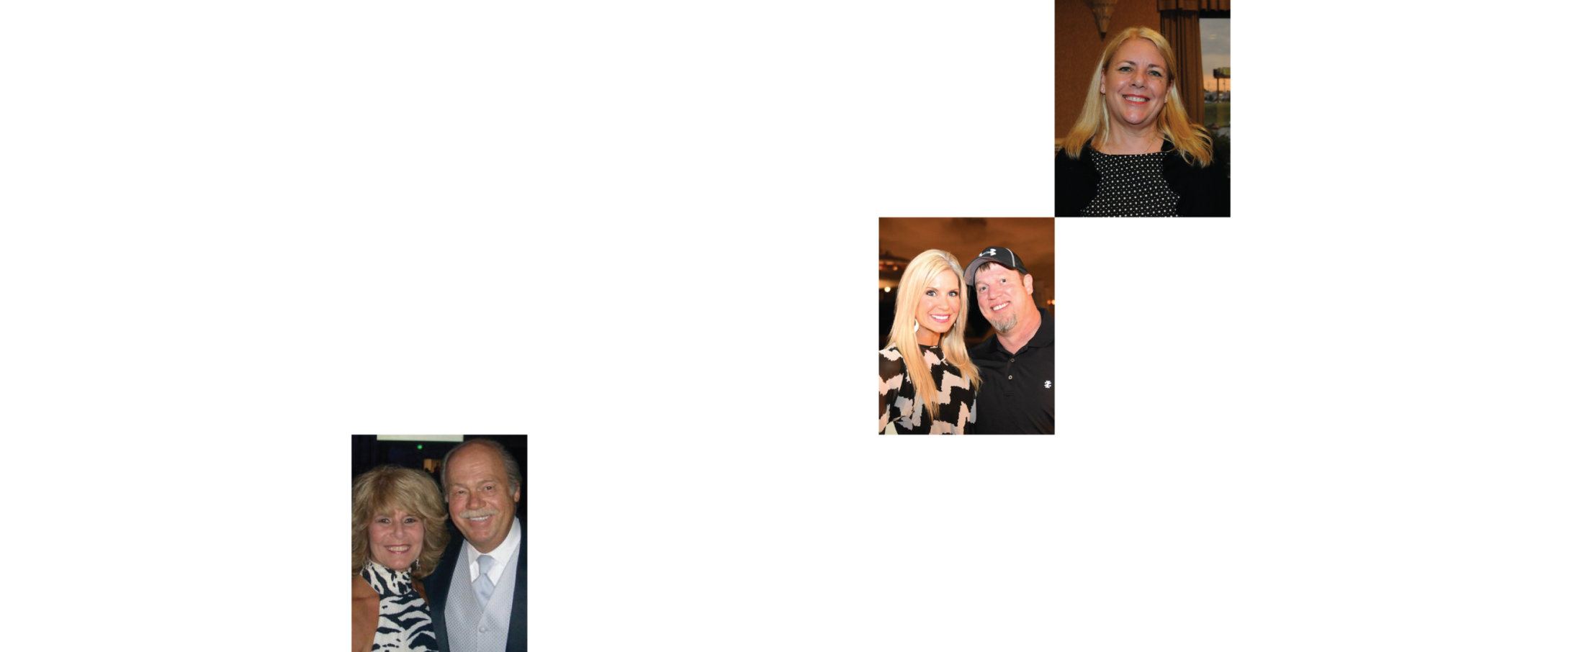
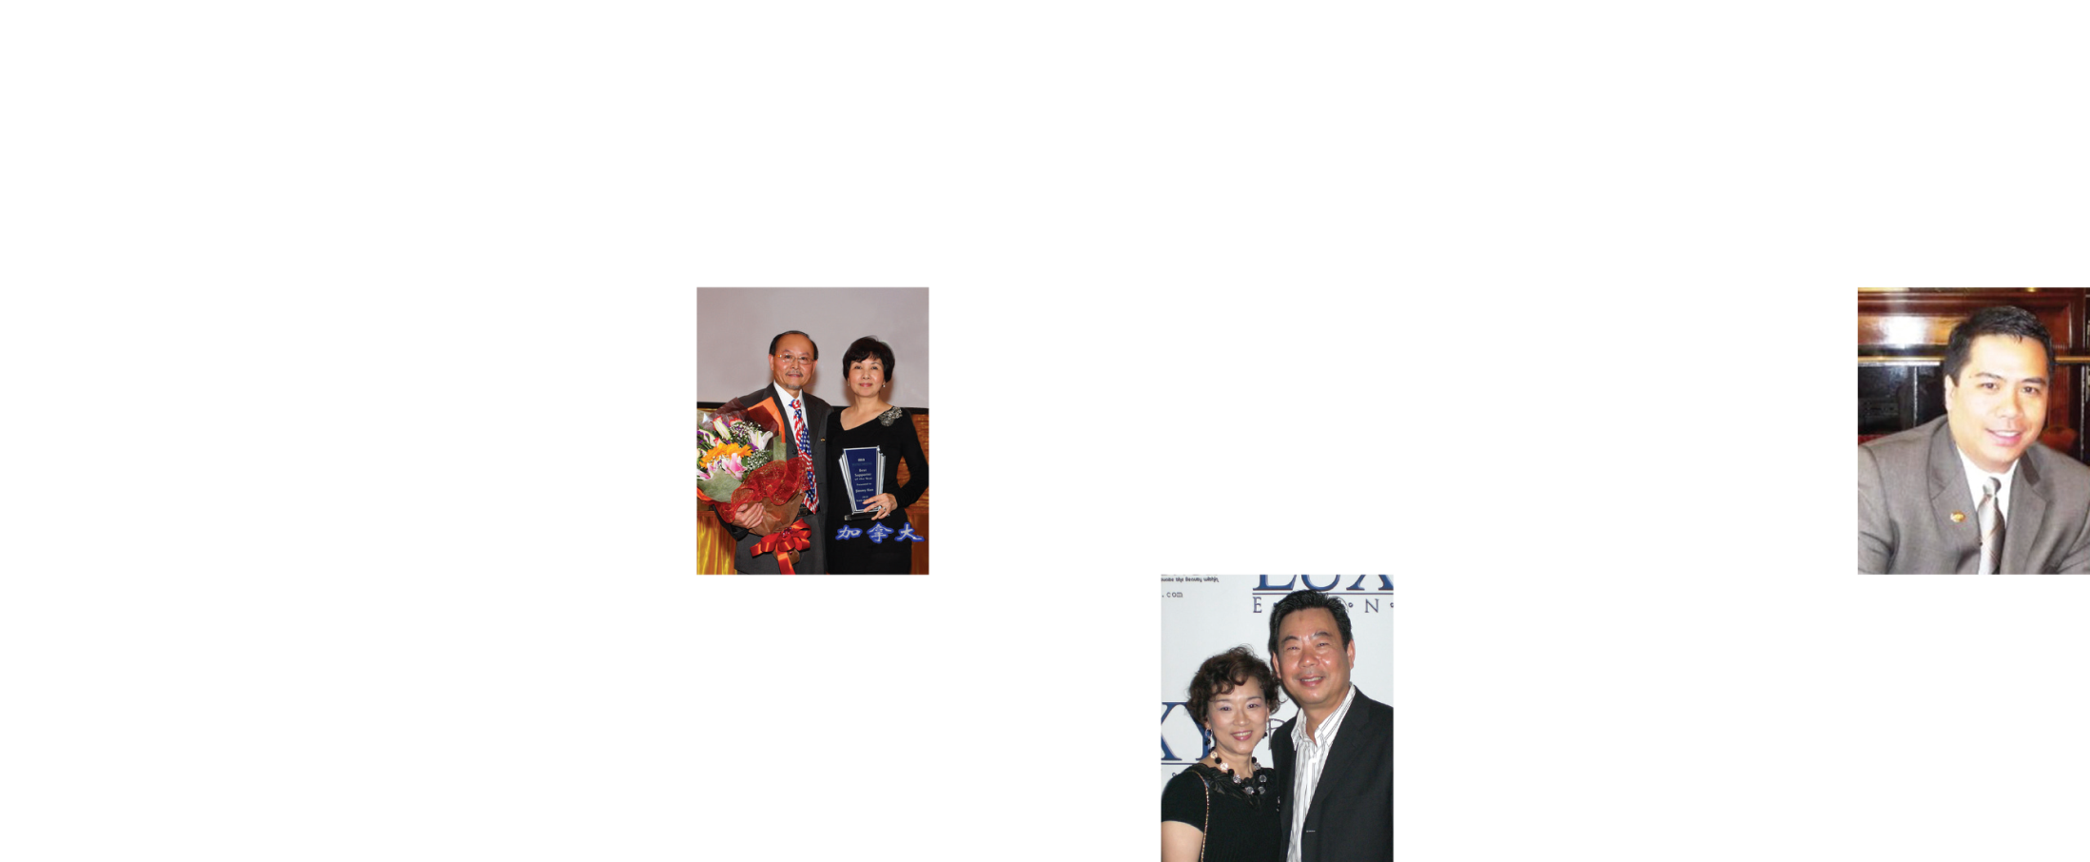
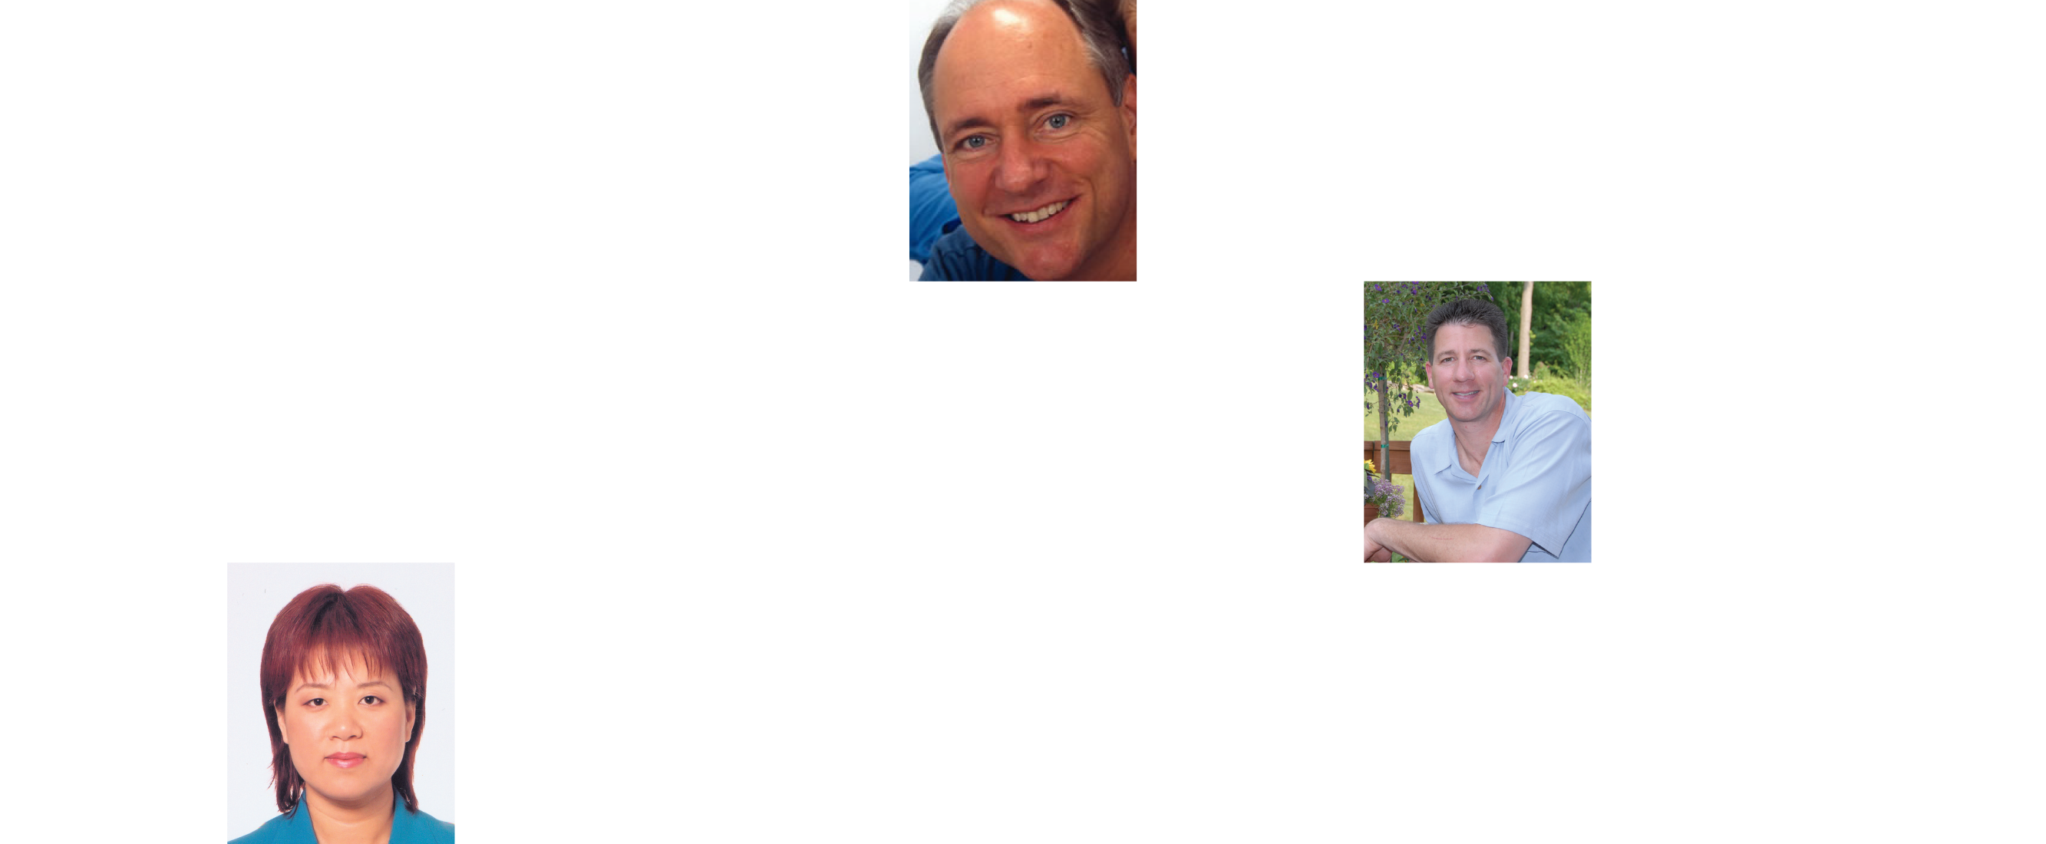
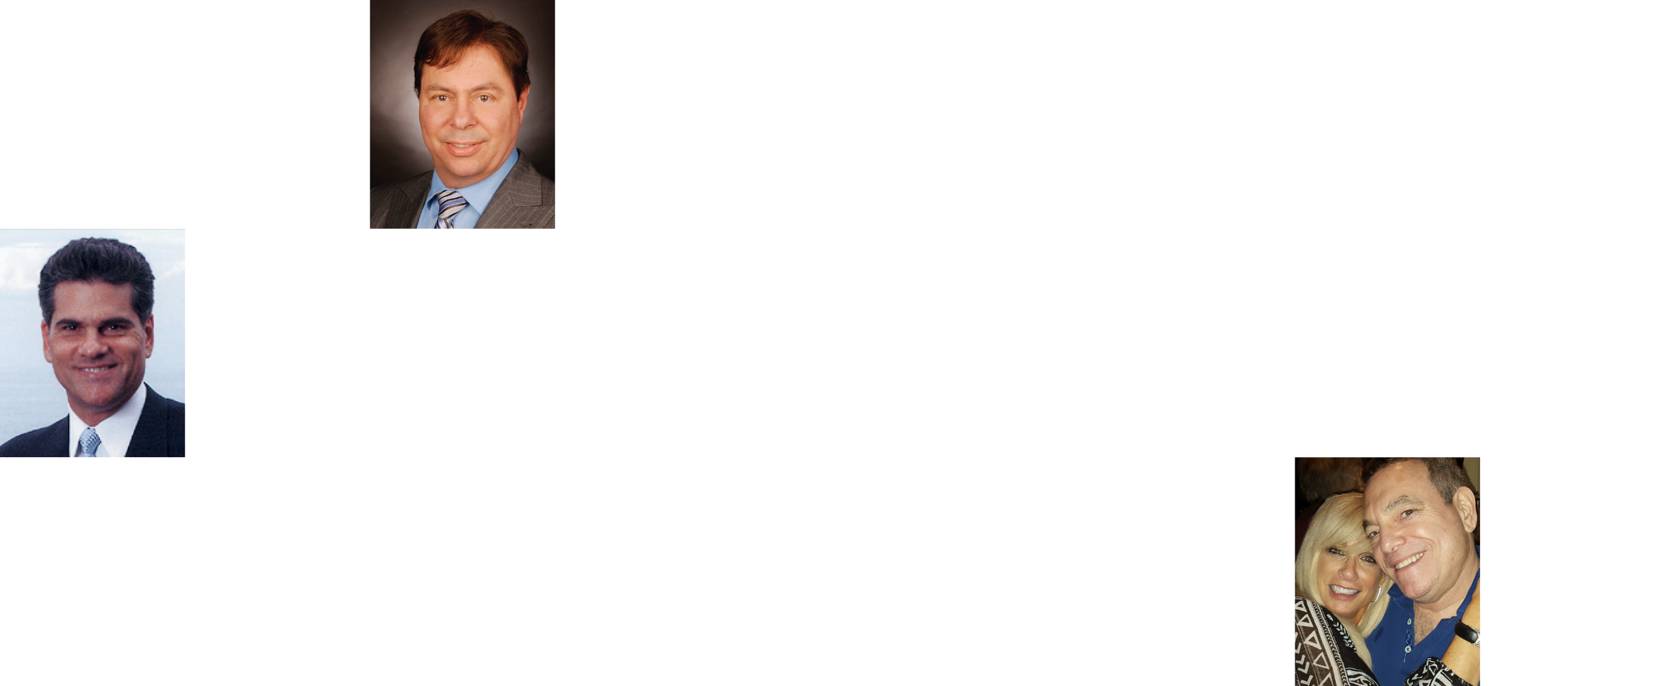
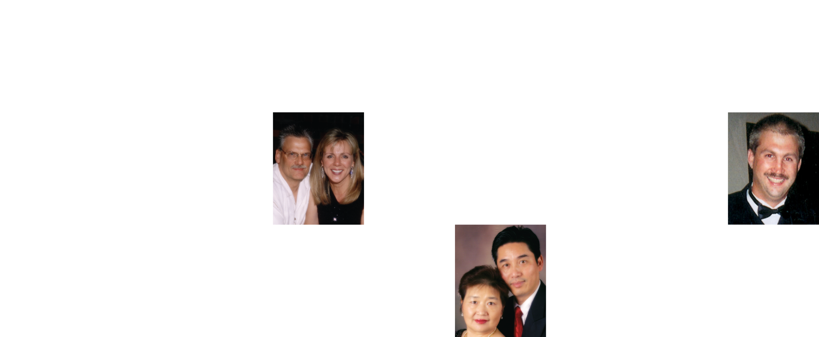
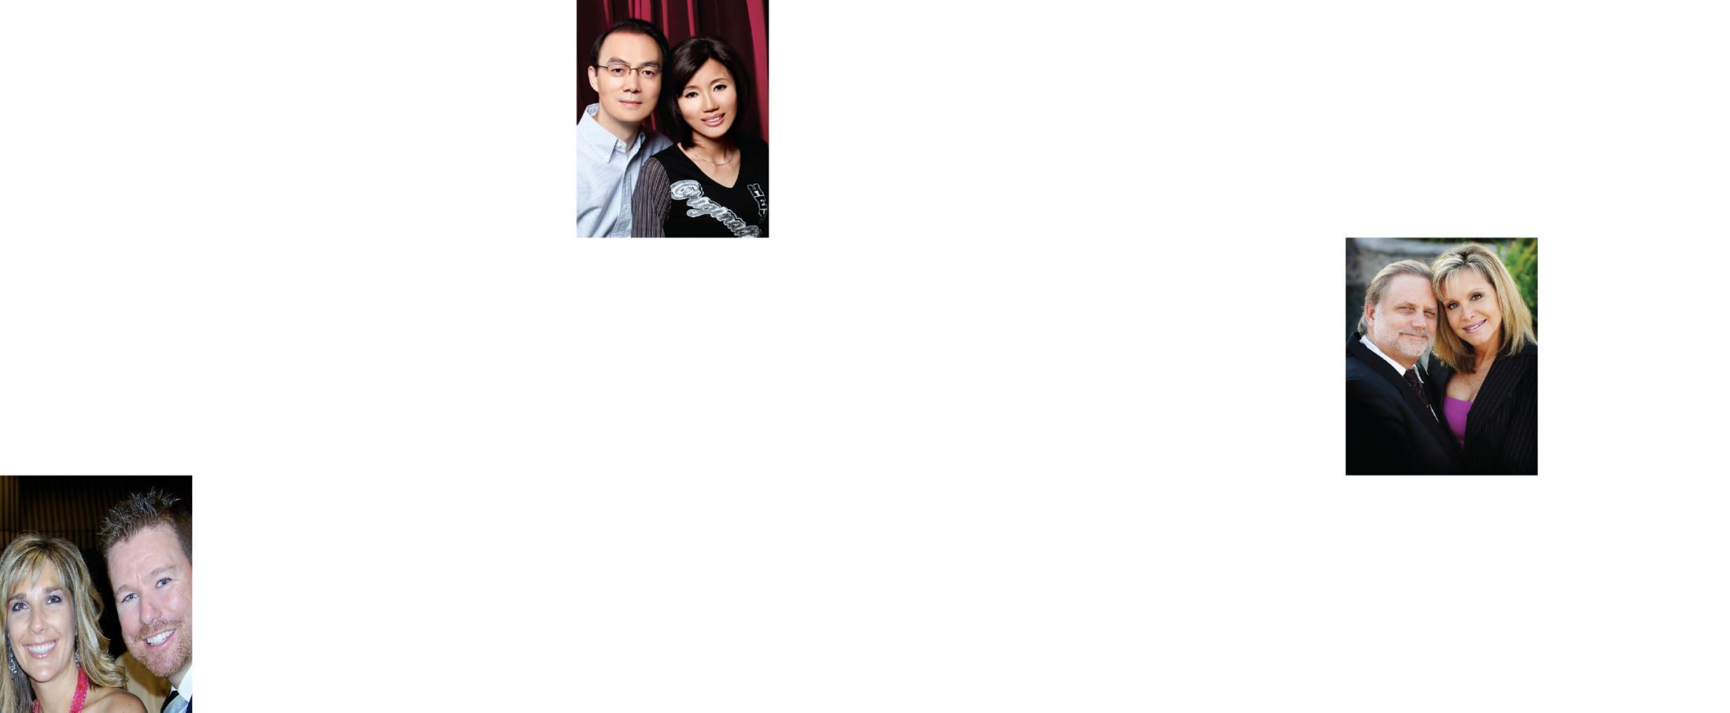
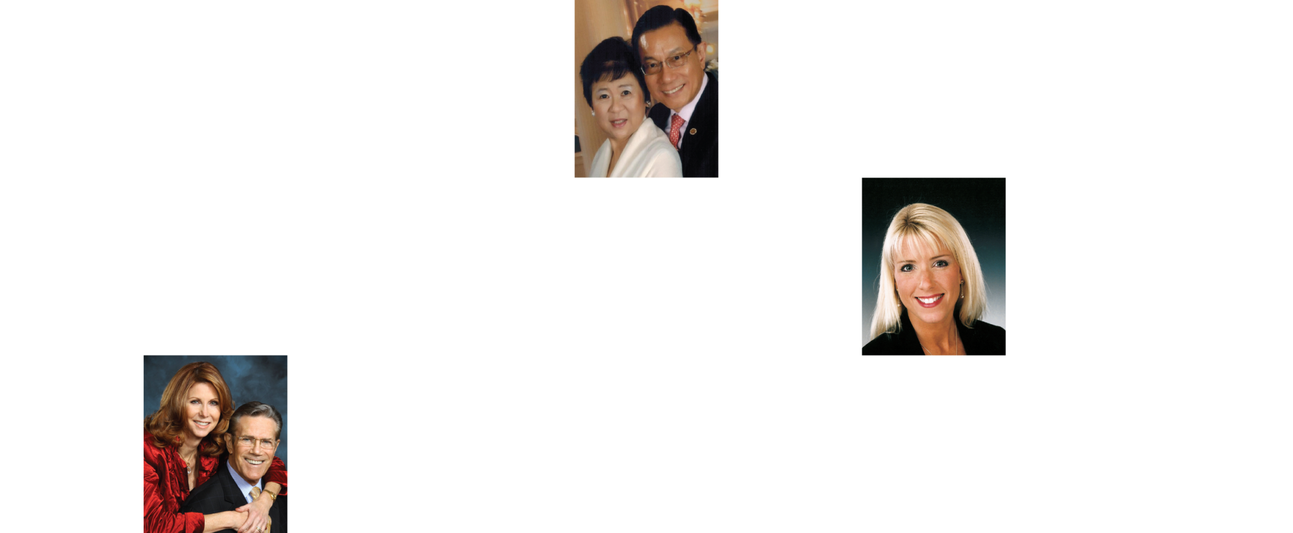
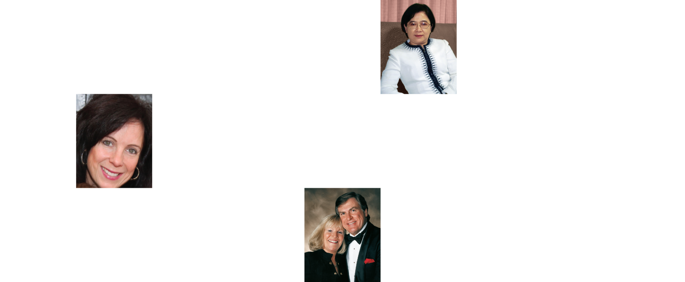
EARNED OVER ONE MILLION DOLLARS IN COMMISSIONS
MARKET AMERICA | SHOP.COM IS CHANGING THE WAY THAT PEOPLE SHOP SO EVERYONE CAN BECOME FINANCIALLY INDEPENDENT BY CREATING THEIR OWN ECONOMY

Slide 29
享受人生 ENJOY LIFE
Time Freedom
Financial Freedom

Slide 30
Chinese Leadership Council (CLC) Presidents
1998 &1999 Vikki Lee | 2009 May Wang
2000 Nina Hale | 2010 James & Marian Kuo
2001 Catherine Ma & Shu Yang | 2011 Min Chen & Wei Wang
2002 Joanne Hsi | 2012 Daniel Kao & Haidong
2003 Allen Hu | 2013 Johnson & Susan Li
2004 Kathy Cheng | 2014 Donald Qi & Jingying Liu
2005 Amy Liu | 2015 Larry Cao & Lucy Liu
2006 Allen Hu | 2016 Robert and Rose Wang
2007 Johnson & Susan Li | 2017 Amber Yang and Michael Lu
2008 Cindy Eng | 2018 Min Liu

Slide 31
Breakthrough / Magic Moment

Slide 32
Learning Processing
Measure
Monitor
Adjust
Control

Slide 33
Growth of MA Business

Slide 34
Belief…..

Slide 35
Four Keys to the Next Level
Belief in the plan
Belief in the product
Belief in the company – 100%
Belief in yourself

Slide 36
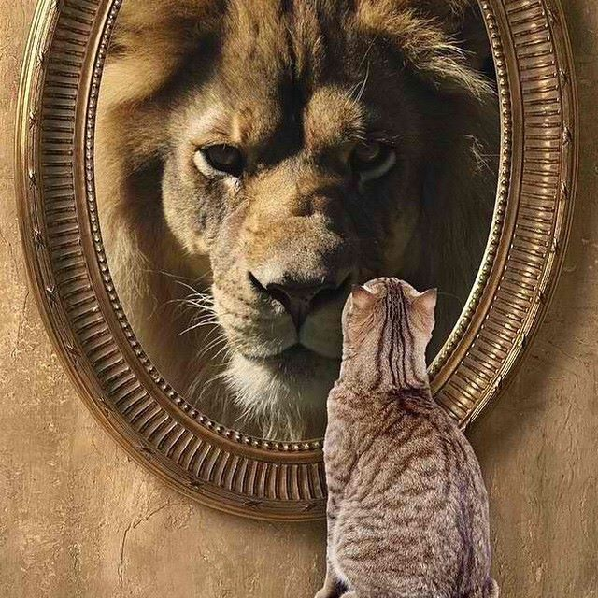
BELIEVE

